Slide 1
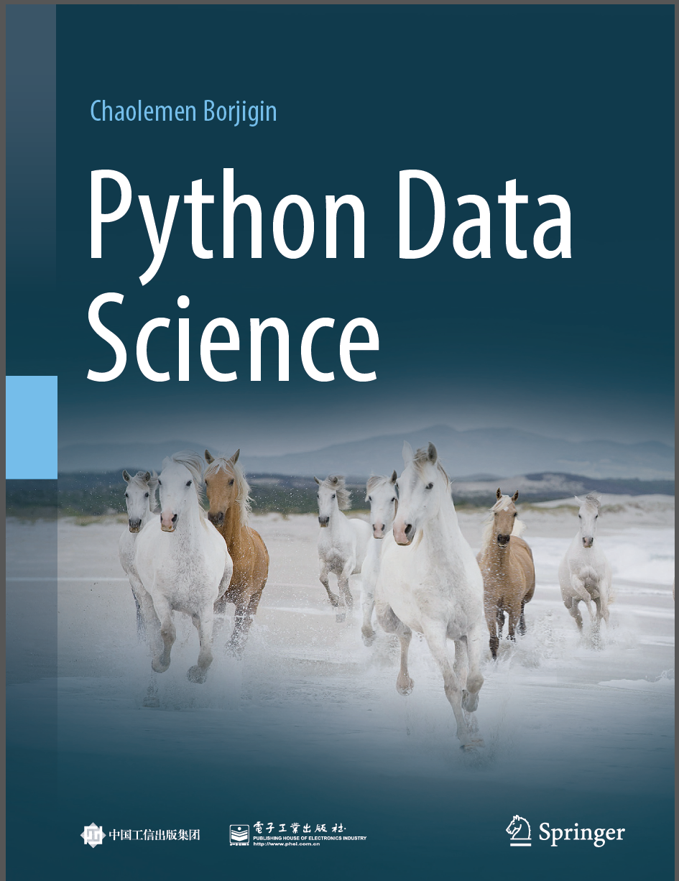
Python Data Science
Chaolemen Borjigin
Renmin University of China
chaolemen@ruc.edu.cn

Slide 2
2.5 Assignment statements
▼ Chapter 2 Basic Python Programming for Data Science
► 2.5 Assignment statements
Chaolemen Borjigin
Renmin University of China
chaolemen@ruc.edu.cn

Slide 3
Summary of this chapter
▼ Chapter 2 Basic Python Programming for Data Science
► 2.5 Assignment statements
2.5.1 Assigning objects
2.5.2 Chained assignment statements
2.5.3 Augmented assignment statements
2.5.4 Sequence unpacking
2.5.5 Swapping two variables

Slide 4
2.5.1 Assigning objects
▼ Chapter 2 Basic Python Programming for Data Science
► 2.5 Assignment statements
In[1]:
i=1
i
Out[1]:
1

Slide 5
2.5.2 Chained assignment statements
▼ Chapter 2 Basic Python Programming for Data Science
► 2.5 Assignment statements
In[2]:
i=j=2
i
j
Out[2]:
2
In[3]:
j=2
i=j
i
j
Out[3]:
2

Slide 6
2.5.3 Augmented assignment statements
▼ Chapter 2 Basic Python Programming for Data Science
► 2.5 Assignment statements
In[4]:
i=1
i+=20
i
Out[4]:
2

Slide 7
2.5.4 Sequence unpacking
▼ Chapter 2 Basic Python Programming for Data Science
► 2.5 Assignment statements
In[6]:
a,b,c=1,2,3
a,b,c
Out[6]:
(1, 2, 3)

Slide 8
2.5.5 Swapping two variables
▼ Chapter 2 Basic Python Programming for Data Science
► 2.5 Assignment statements
In[7]:
a=1
b=2
a,b=b,a
a,b
Out[7]:
(2, 1)

Slide 9


